Slide 1

Real Estate Price Prediction using Multiple Linear Regression
Atharva Chavan I014
Avnish Chitrigi I015
Ayush Kadam I016
Dipto Sen I026

Slide 2

Introduction
In this Project we are trying to find the house price which is our dependent variable and comparing it to multiple different variables which our our independent variables which would eventually affect our dependent variable.
Hence we use Multiple linear regression to predict the outcome of our dependent variable.
Notes:
Image compression is a type of data compression that reduces the file size of digital images.

Slide 3
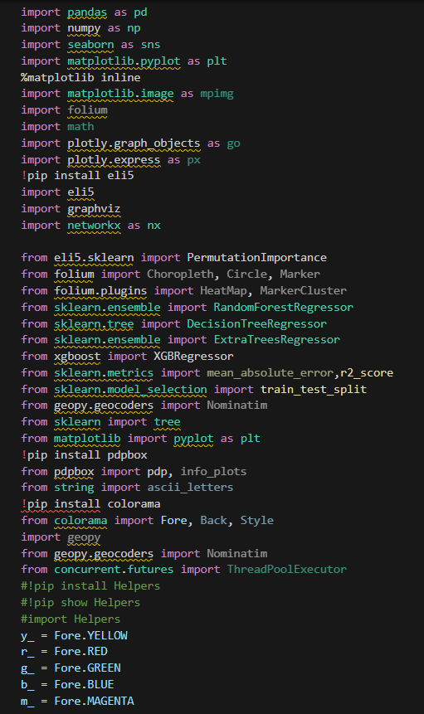
Libraries that were imported:-

Slide 4
Graph plots that were constructed:
1. Triple plot which consisted of:-
(1) Histogram plot
(2) Box plot
(3) Violin plot
2. Count plot
3.Cat plot
4.Scatter plot

Slide 5

Application
Real estate companies can utilize the predictive model to offer more accurate pricing estimates to clients, improving customer satisfaction and trust.
Homebuyers can use the model to assess whether a property is priced reasonably based on its characteristics, aiding in informed decision-making.
Investors can leverage the model to identify potentially undervalued properties or forecast future price trends, optimizing their investment strategies.
Governments and urban planners can employ the model to analyze housing market dynamics and inform policy decisions related to housing affordability and urban development.
Insurance companies can integrate the model to evaluate property values accurately for insurance coverage and claims processing.

Slide 6

Methodology (Steps)
Libraries import
Data import and read
DATA CLEANING
GEOCODING
FEATURE GENERATION
VISUALISATION
DATA PREPROCESSING
HYPERPARAMETER TUNING AND MODEL CREATION
WEB APP DEPLOYMENT

Slide 7

References
https://www.kaggle.com/code/ruchi798/housing-prices-eda-and-prediction
1

